Slide 1
Intro to Probability

Slide 2
Why is Probability Important in Data Science?
Probability lets us model uncertainties.
Probabilities can be used to make classifications.
Probability lets us make statements about a population.
Many ML methods depend on probability distribution assumptions
Linear Regression assumes the residuals are normally distributed
Gaussian Naive Bayes assumes the predictors are normally distributed
Probability distributions can be useful to create ‘toy’ datasets to test out methods.

Slide 3
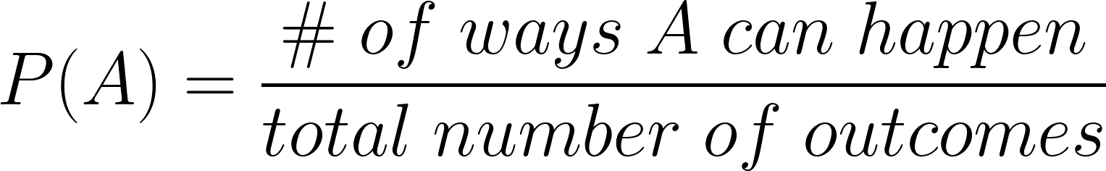
What is Probability?
A is an event. We read P(A) as “the probability of event A” or “the probability of A”. Note that the probability of a single event is called a marginal probability.

Slide 4
Basic Probability Examples
What is the probability of pulling out a blue marble from a bag that contains 3 yellow marbles, 4 green marbles, and 2 blue marbles?

Slide 5
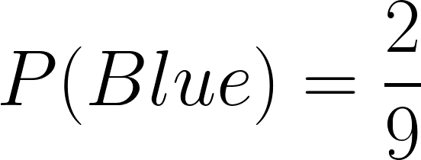
Basic Probability Examples
What is the probability of pulling out a blue marble from a bag that contains 3 yellow marbles, 4 green marbles, and 2 blue marbles?
Sample Space

Slide 6
Basic Probability Examples
What is the probability of pulling out a non-blue marble from a bag that contains 3 yellow marbles, 4 green marbles, and 2 blue marbles?

Slide 7
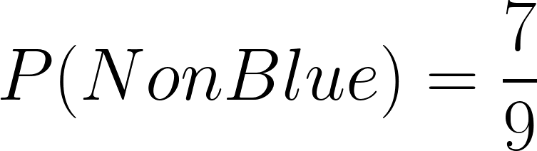
Basic Probability Examples
What is the probability of pulling out a non-blue marble from a bag that contains 3 yellow marbles, 4 green marbles, and 2 blue marbles?
Sample Space

Slide 8
Basic Probability Examples
What is the probability of rolling doubles on two six-sided die?

Slide 9
Basic Probability Examples
What is the probability of rolling doubles on two six-sided die?
Roll 1
Total number of outcomes:
6 x 6 = 36
 | 1 | 2 | 3 | 4 | 5 | 6
1
2
3
4
5
6
Roll 2

Slide 10
Basic Probability Examples
What is the probability of rolling doubles on two six sided die?
Roll 1
Total number of outcomes:
6 x 6 = 36
 | 1 | 2 | 3 | 4 | 5 | 6
1
2
3
4
5
6
Number ways:
6
Roll 2

Slide 11
Basic Probability Examples
What is the probability of rolling doubles on two six sided die?
Roll 1
Total number of outcomes:
6 x 6 = 36
 | 1 | 2 | 3 | 4 | 5 | 6
1
2
3
4
5
6
Number ways:
6
Roll 2
Number ways ÷
Total number of outcomes
= 6 / 36
= 1/6

Slide 12
Probability Rules
Addition Rule ( “OR” events)
Multiplication Rule ( “AND” events )

Slide 13
Probability Rules
Addition Rule
P(A or B) = P(A) + P(B) - P(A and B)
Addition Rule (Mutually Exclusive)
P(A or B) = P(A) + P(B)
A
B
A
B

Slide 14
Probability Rules
Addition Rule
P(A or B) = P(A) + P(B) - P(A and B)
Addition Rule (Mutually Exclusive)
P(A or B) = P(A) + P(B)
A
B
A
B
If not sure, use the non-mutually exclusive formula. P(A and B) == 0, for mutually exclusive events.

Slide 15
Addition Rule Examples
What is the probability of pulling out a blue marble OR a yellow marble from a bag that contains 3 yellow marbles, 4 green marbles, and 2 blue marbles?

Slide 16
Addition Rule Examples
What is the probability of pulling out a blue marble OR a yellow marble from a bag that contains 3 yellow marbles, 4 green marbles, and 2 blue marbles?
P(Blue or Yellow)
= P(Blue) + P(Yellow)
= 2/9 + 3/9
= 5/9

Slide 17
Addition Rule Examples
If you draw a single card from a deck of cards, what is the probability the card is either a diamond OR an ace?

Slide 18
Addition Rule Examples
If you draw a single card from a deck of cards, what is the probability the card is either a diamond OR an ace?
P(Diamond) =
P(Ace) =
P(Diamond and Ace) =
P(Diamond or Ace)

Slide 19
Addition Rule Examples
If you draw a single card from a deck of cards, what is the probability the card is either a diamond OR an ace?
P(Diamond) = 13/52
P(Ace) = 4/52
P(Diamond and Ace) = (13/52) x (4/52) = 1/52
P(Diamond or Ace)
= P(Diamond) + P(Ace) - P(Diamond and Ace)
= 13/52 + 4/52 - 1/52
= 16/52

Slide 20
Probability Rules
Multiplication Rule - Note: This rule only applies for independent events!
If the first event happening impacts the probability of the second event, the events are dependent.
If the first event happening does not impact the probability of the second event, the events are independent.
P(A and B) = P(A)*P(B)
Note that the probability of two events occurring is called a joint probability.

Slide 21
Multiplication Rule Examples
If you roll two six-sided die, what is the probability that you roll two 5s?

Slide 22
Multiplication Rule Examples
If you roll two six-sided die, what is the probability that you roll two 5s?
P(First Roll = 5) =
P(Second Roll = 5) =
P(First & Second Rolls = 5) =

Slide 23
Multiplication Rule Examples
If you roll two six-sided die, what is the probability that you roll two 5s?
P(First Roll = 5) = 1/6
P(Second Roll = 5) = 1/6
P(First & Second Rolls = 5) = 1/6 x 1/6
= 1/36

Slide 24
Probability Questions
1. A bag contains 2 orange, 3 purple and 2 yellow balls. Two of the balls are randomly drawn with replacement. What is the probability that none of the balls drawn is yellow?

Slide 25
Probability Questions
1. A bag contains 2 orange, 3 purple and 2 yellow balls. Two of the balls are randomly drawn with replacement. What is the probability that none of the balls drawn is yellow?
Total number of balls = 2 + 3 + 2 = 7
P( draw_1 = Yellow ) = 2/7 => P( draw_1 != Yellow ) = 5/7
P( draw_2 = Yellow ) = 2/7 => P( draw_2 != Yellow ) = 5/7
P( none yellow ) = P( draw_1 != Yellow ) x P( draw_2 != Yellow )
= 5/7 x 5/7
= 25/49

Slide 26
Probability Questions
2. A normal deck of cards has 52 cards in it. Assuming that you DON'T replace the card you had drawn before the next draw, what is the probability that you will draw three kings in a row?

Slide 27
Probability Questions
2. A normal deck of cards has 52 cards in it. Assuming that you DON'T replace the card you had drawn before the next draw, what is the probability that you will draw three kings in a row?
P( draw_1 = king ) = 4/52
P( draw_2 = king ) = 3/51
P( draw_3 = king ) = 2/50
P( 3 kings ) = P( draw_1 = king ) x P( draw_2 = king ) x P( draw_3 = king )
= 4/52 x 3/51 x 2/50
= 1/5,525

Slide 28
Probability Questions
3. Around 0.8% of men are blue-green colour-blind (the figure is slightly different for women) and roughly 1 in 5 men is left-handed. Assuming these characteristics are inherited independently, calculate the probability that a man chosen at random will:
(i) be both colour-blind and left-handed
(ii) be colour-blind and not left-handed
(iii) be colour-blind or left-handed
(iv) be neither colour-blind nor left-handed.

Slide 29
Probability Questions
3. Around 0.8% of men are blue-green colour-blind (the figure is slightly different for women) and roughly 1 in 5 men is left-handed. Assuming these characteristics are inherited independently, calculate the probability that a man chosen at random will:
Let’s assume 10,000 men …
(i) be both colour-blind and left-handed
0.16% = 80/10,000 x 2,000/10,000 = 16/10,000
(ii) be colour-blind and not left-handed
0.64% = 80/10,000 x (10,000 - 2,000)/10,000 = 640/10,000
(iii) be colour-blind or left-handed
20.64% = 80/10,000 + 2,000/10,000 - 16/10,000 = 2,064/10,000
(iv) be neither colour-blind nor left-handed.
79.36% = (10,000 - 80)/10,000 * (10,000 - 2,000)/10,000 = 7,936/10,000

Slide 30
Probability Questions
3. Around 0.8% of men are blue-green colour-blind (the figure is slightly different for women) and roughly 1 in 5 men is left-handed. Assuming these characteristics are inherited independently, calculate the probability that a man chosen at random will:
(i) be both colour-blind and left-handed
0.16% = 0.008 x 0.2
(ii) be colour-blind and not left-handed
0.64% = 0.008 x ( 1 - 0.2 )
(iii) be colour-blind or left-handed
20.64% = 0.008 + 0.2 - 0.0016
(iv) be neither colour-blind nor left-handed.
79.36% = ( 1 - 0.008 ) x ( 1 - 0.2 ) = 1 - (iii)

Slide 31
Probability Questions
3. Around 0.8% of men are blue-green colour-blind (the figure is slightly different for women) and roughly 1 in 5 men is left-handed. Assuming these characteristics are inherited independently, calculate the probability that a man chosen at random will:
(i) be both colour-blind and left-handed
(ii) be colour-blind and not left-handed
(iii) be colour-blind or left-handed
(iv) be neither colour-blind nor left-handed.
 | Color blind | Not color blind
Left handed | 0.16% (0.2*0.008) | 19.84 (0.2*0.992) | 20%
Not left handed | 0.64% (0.8*0.008) | 79.36% (0.8*0.992) | 80%
 | 0.8% | 99.2% | 100%

Slide 32
Random Variables
A random variable is a variable that can take on more than one value.
When dealing with random variables, it is often useful to think about the sample space for that variable.
Examples
Rolling a die
Height of men
A probability distribution is a function that provides the likelihood of seeing each value in a random variable’s sample space.

Slide 33
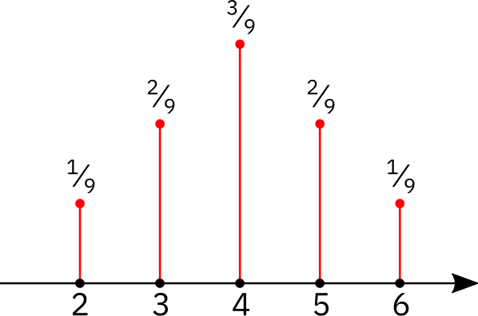
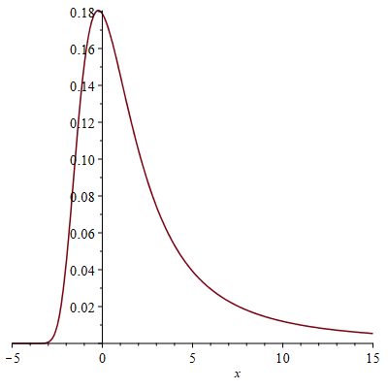
Discrete vs. Continuous Probabilities
Discrete random variables are defined by a probability mass function.
Continuous random variables are defined by a probability density function.

Slide 34
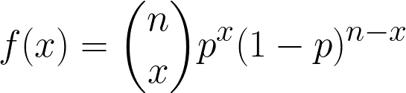
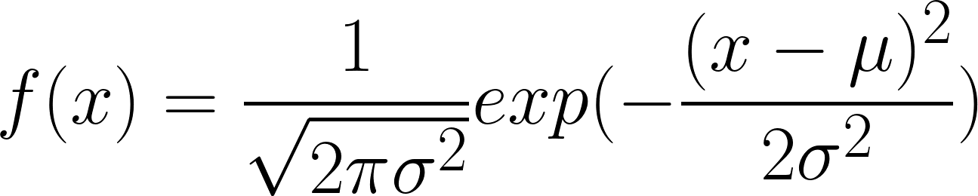
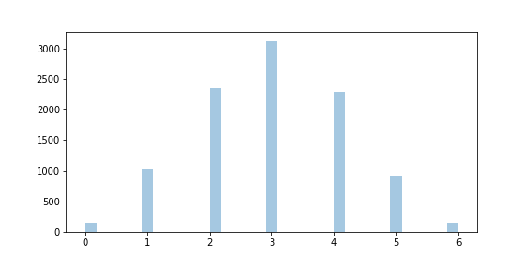
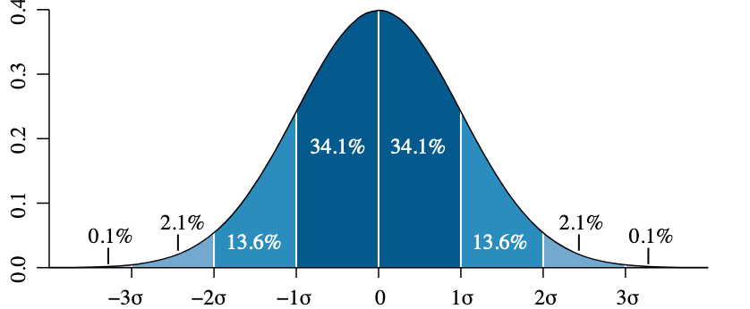
Probability Distributions
Probability distributions have a functional form that is defined by a set of parameters.
Binomial Distribution
Normal Distribution
p is the probability of success (e.g., heads)
n is the number of trials
μ is the sample mean and
σ is the sample standard deviation

Slide 35
Probability Distributions
Binomial Distribution
Normal Distribution
e raised to the value
Euler's constant
Given n, choose x.
Also, n choose x, nCx, nCk, nCr
Math Combination

Slide 36
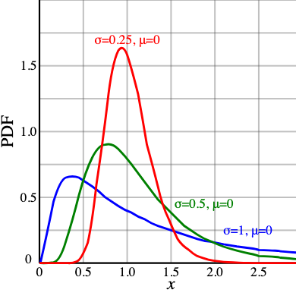
Probability Distributions
There are many other probability distributions. We will discuss them and how to generate samples from probability distributions in Python in a later lecture.

